Slide 1
Aspergillus
A genus of One Health pathogens

Slide 2
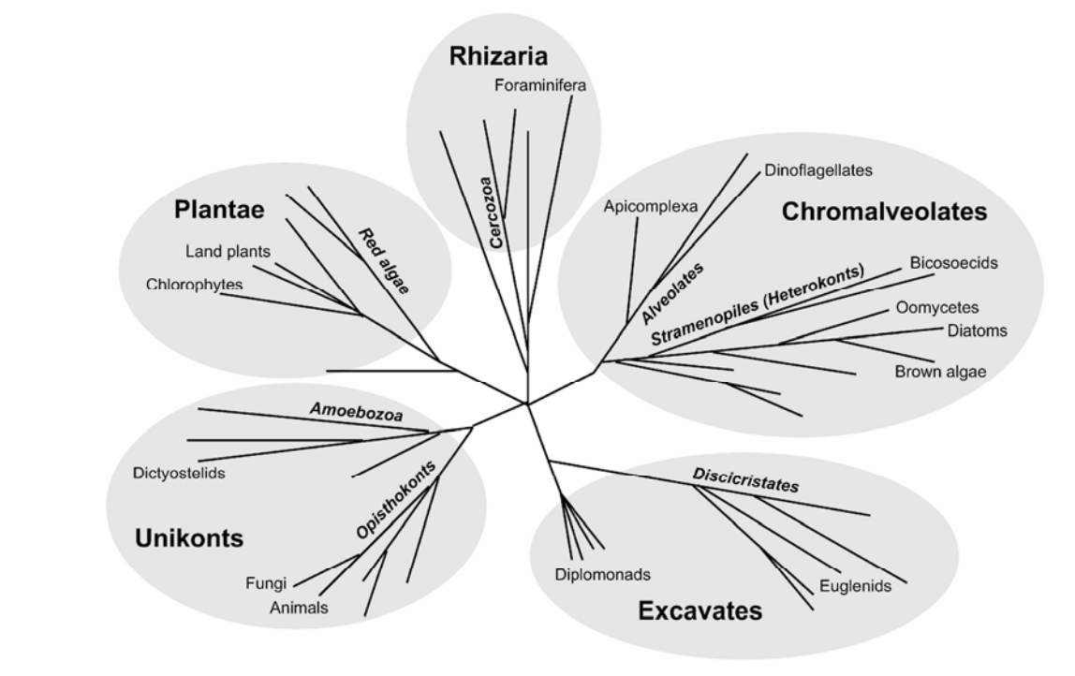
Evolutionary Neighborhood

Slide 3
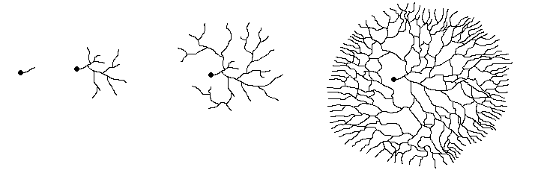
What is a fungus?

Slide 4
What is a fungus?
filamentous structures; most have cross-walls (septa); others are non-septate
a collection of hyphae
dense aggregates of hyphae which serve as overwintering (survival) structures
the spore-producing organ of a fungus (e.g. mushroom, Ascocarp for the ascomycetes, basidiocarp for the basidiomycetes)
Different types are produced during sexual and asexual reproduction. Usually (always?) haploid.

Slide 5
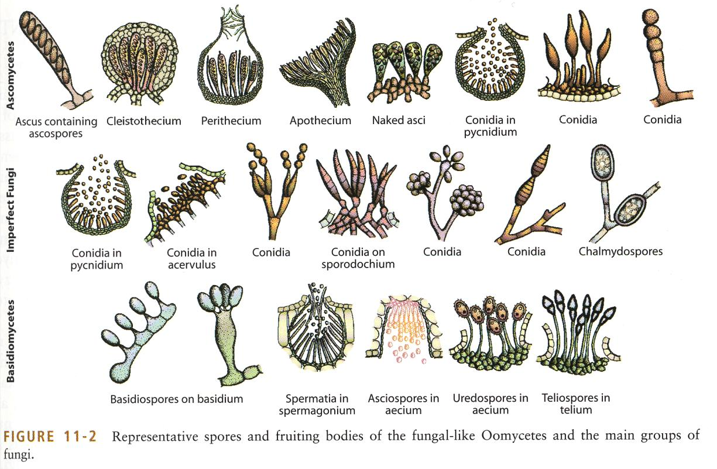
What is a fungus?
Agrios Textbook – buy an old version on Amazon for ~$20 if you want to learn way more about plant pathogens. (Even the newest version is outdated)

Slide 6
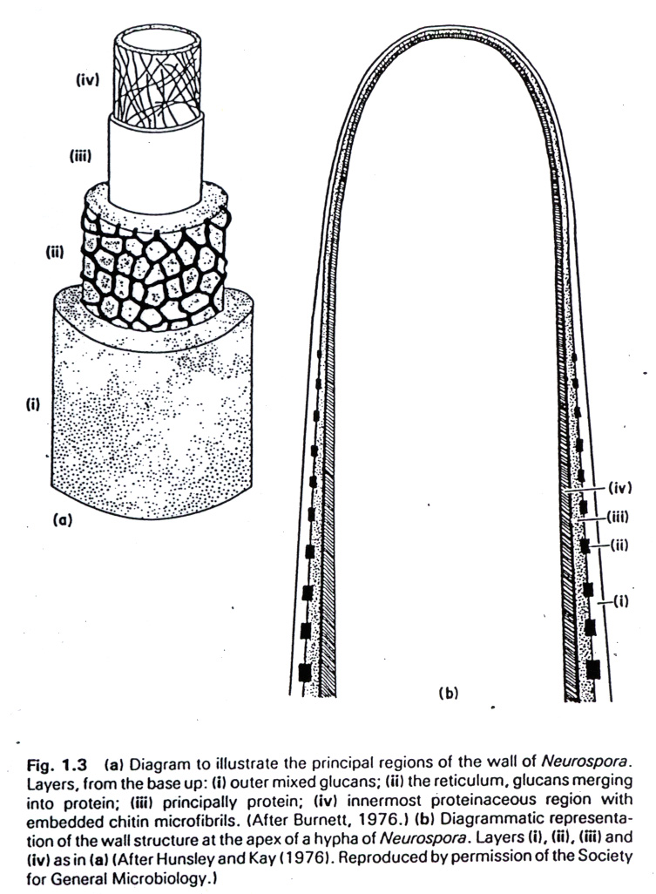
How do filamentous fungi grow and eat?

Slide 7
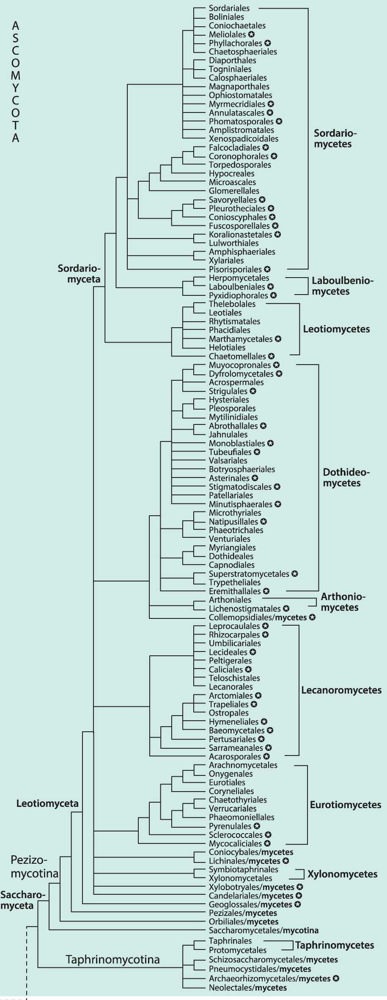
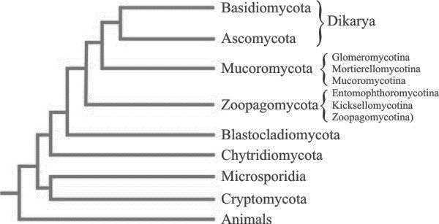
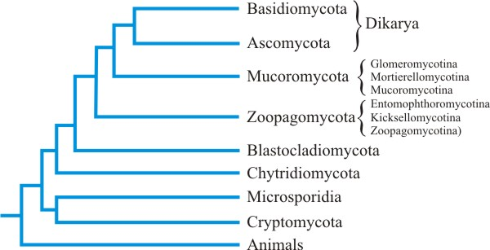
Evolutionary Neighborhood

Slide 8
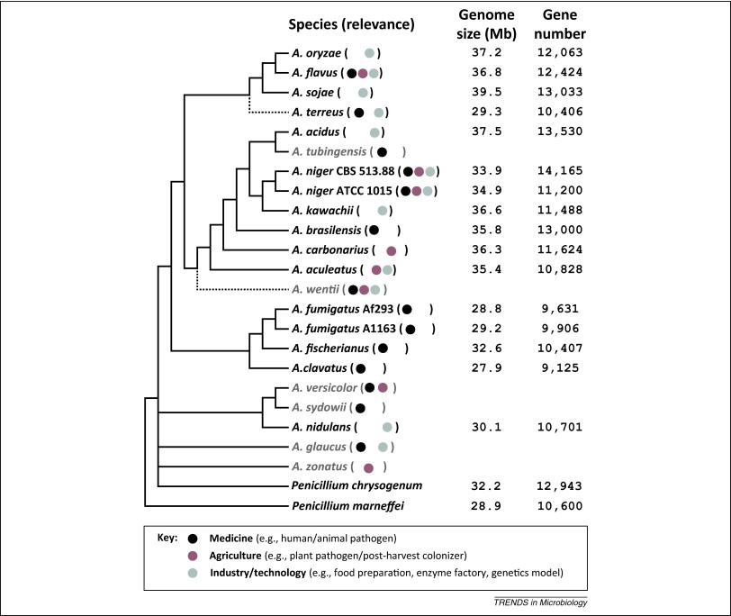
Evolutionary Neighborhood

Slide 9
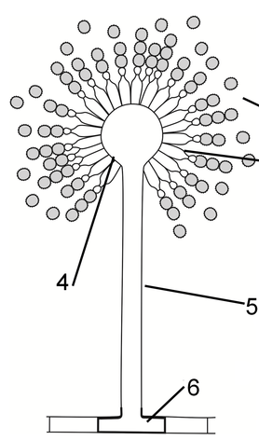
Ecology & Life Cycle: Aspergillus, general
Climate:
Conidiophores
Conidia
Mycelia
Sclerotia

Slide 10
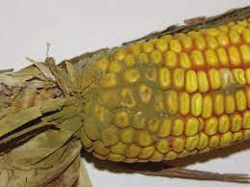
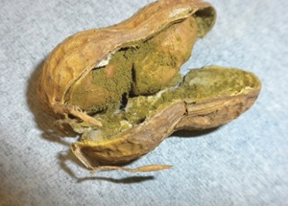
Disease Cycle: A. flavus
Corn
Peanut

Slide 11
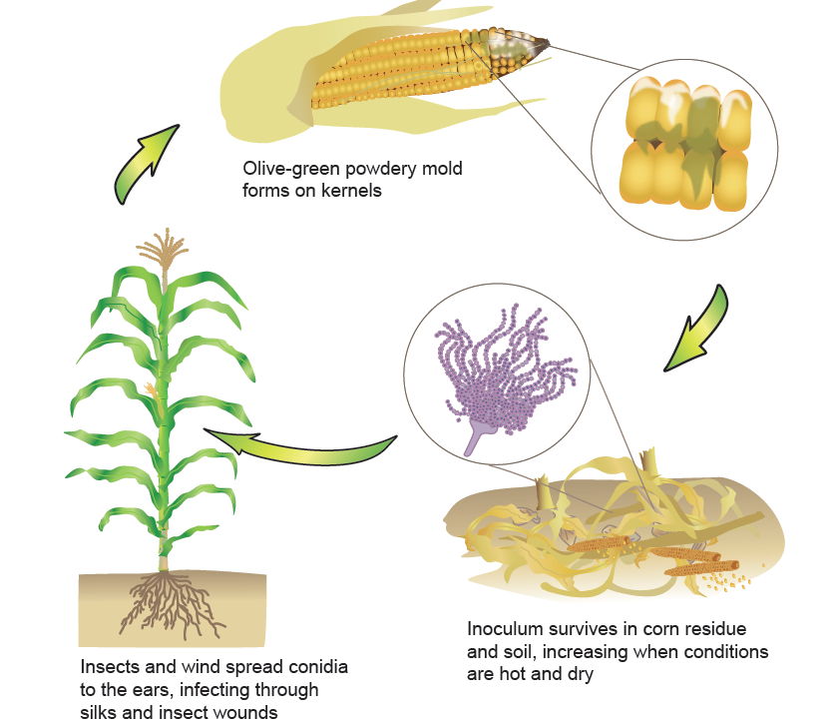
Disease Cycle: A. flavus

Slide 12
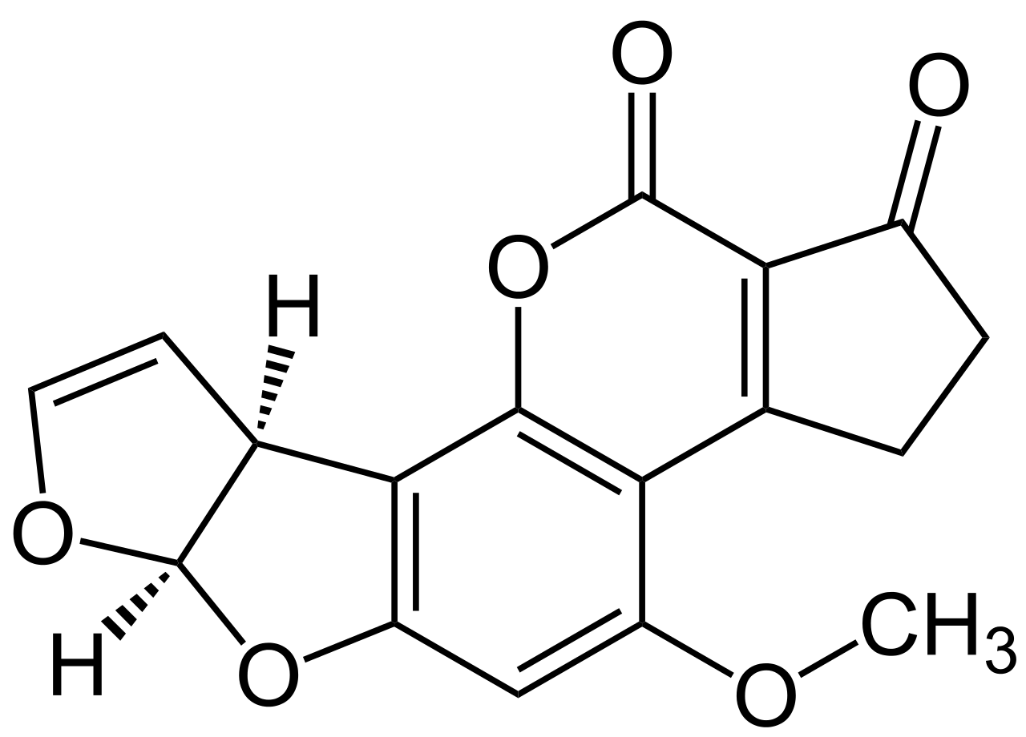
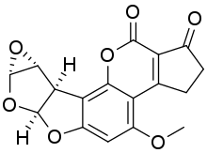
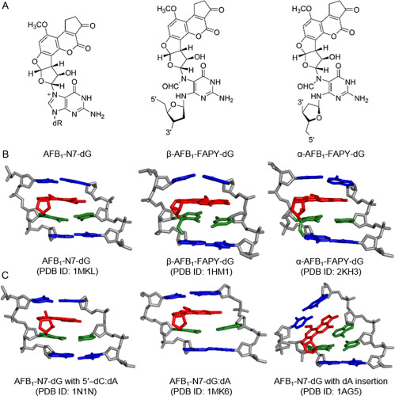
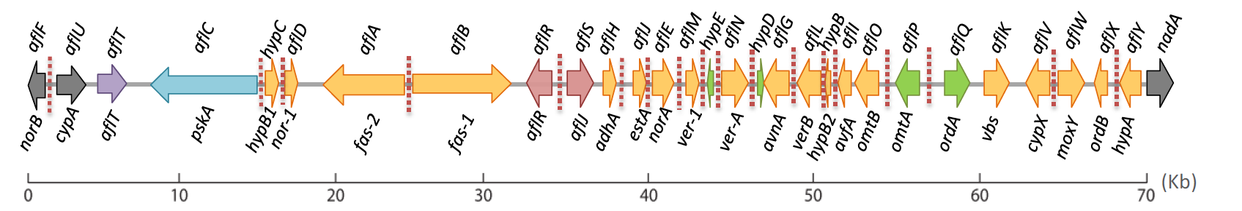
Fitness factors: A. flavus
Mycotoxins
Epoxide

Slide 13
Factors associated with Aflatoxin production
Aflatoxin production associated with:
A. flavus metabolism: consumes free sugars, then oils/lipids, then starch.
Weather:
Storage conditions:

Slide 14
Management: A. flavus
Aflaguard Biological control
Bacillus thuringensis
Cry1Ab
Lepidopterans
Irrigation
Dry storage of seeds

Slide 15
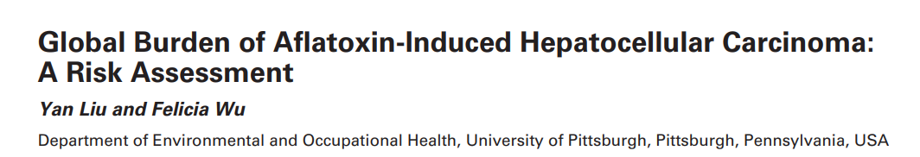
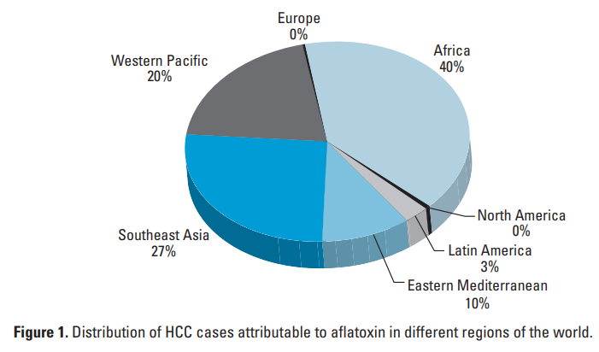

Slide 16
Aspergillus sp. as opportunistic human pathogens

Slide 17
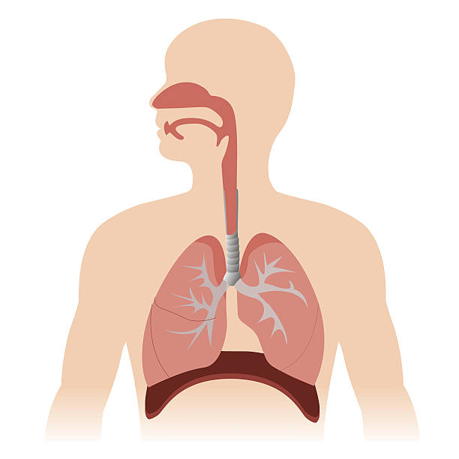
Disease Cycle: A. fumigatus
Conidia

Slide 18
Disease Cycle: A. fumigatus
Disease/conditions that compromise
Invasive aspergillosis steps
Animal defenses

Slide 19
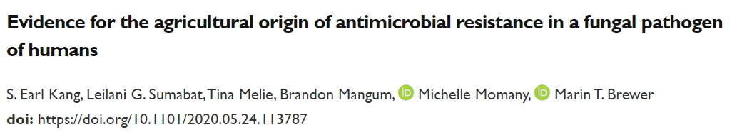
Please read the paper’s title.
Is any jargon unclear?
What will we learn about from this paper?

Slide 20
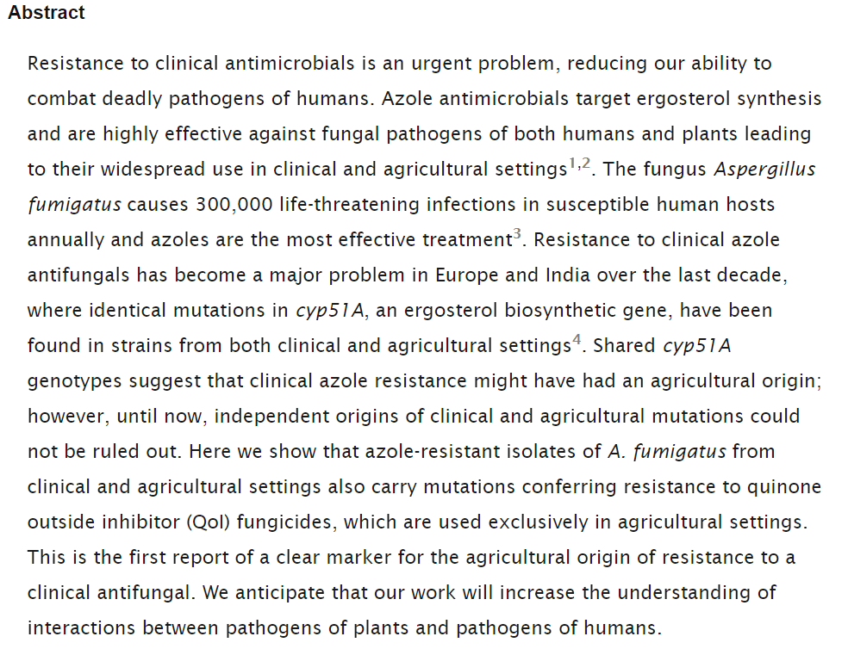
Please read the Abstract.
Is any jargon unclear?
What will we learn about from this paper?

Slide 21
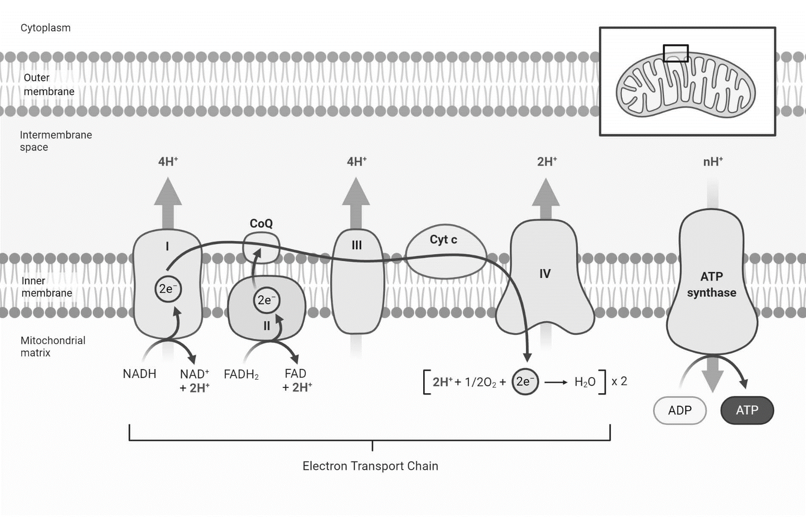
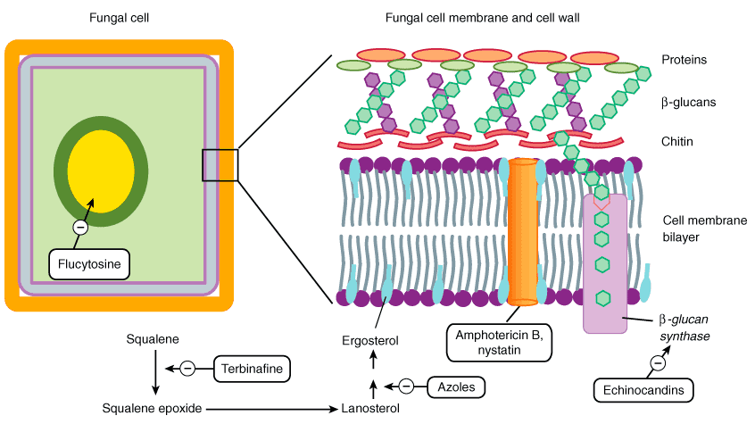
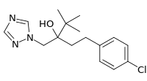
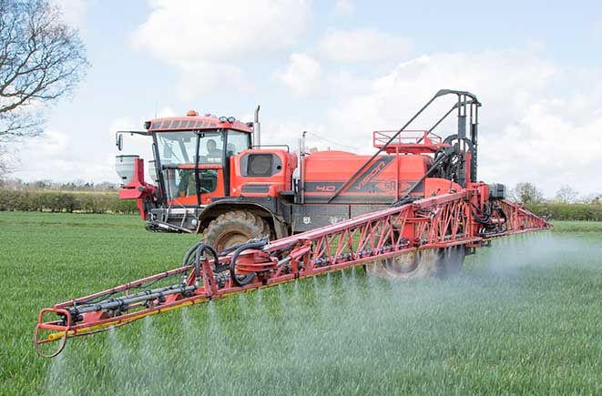
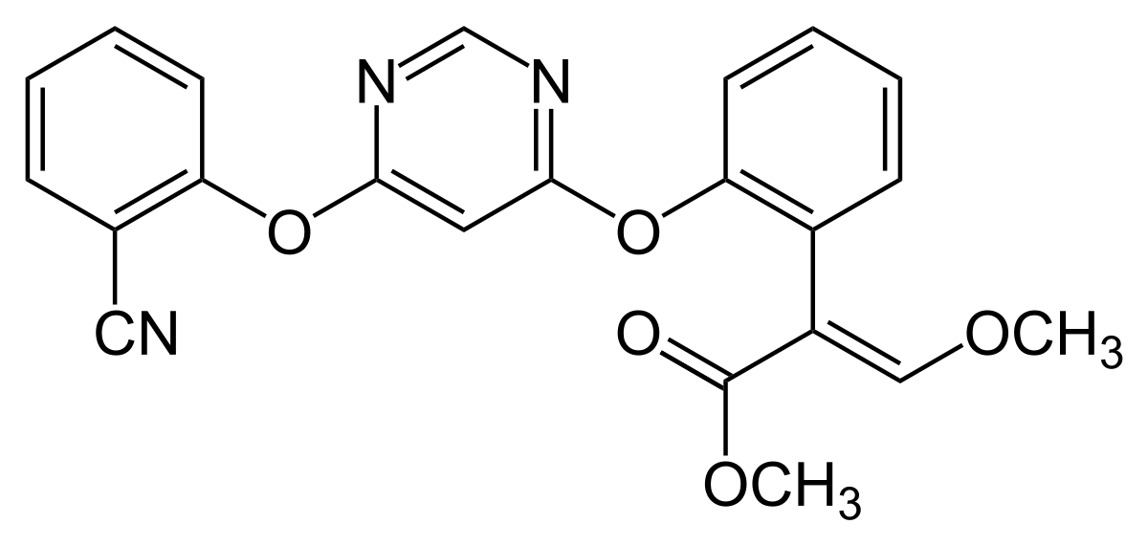
Antifungals in Agriculture
Lanosterol
TEB (tebuconazole) -Agriculture
ITC (Itraconazole)
VOR (voriconazole)
POS (posaconazole)
Which of these anti-fungal classes are clinically useful (why)? AZOLES

Slide 22
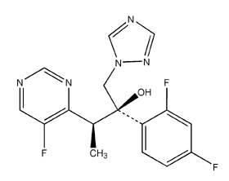
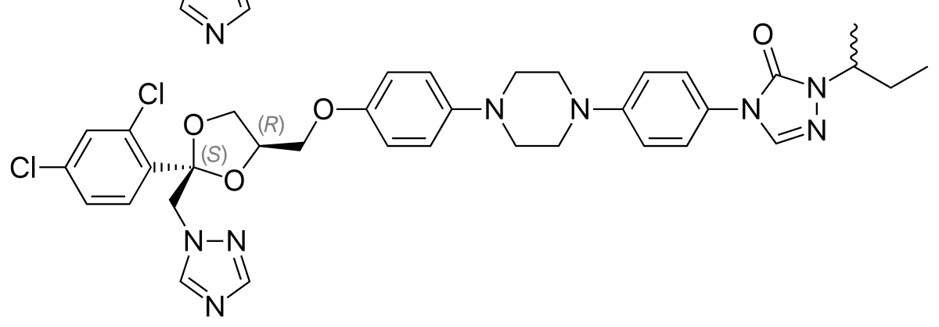
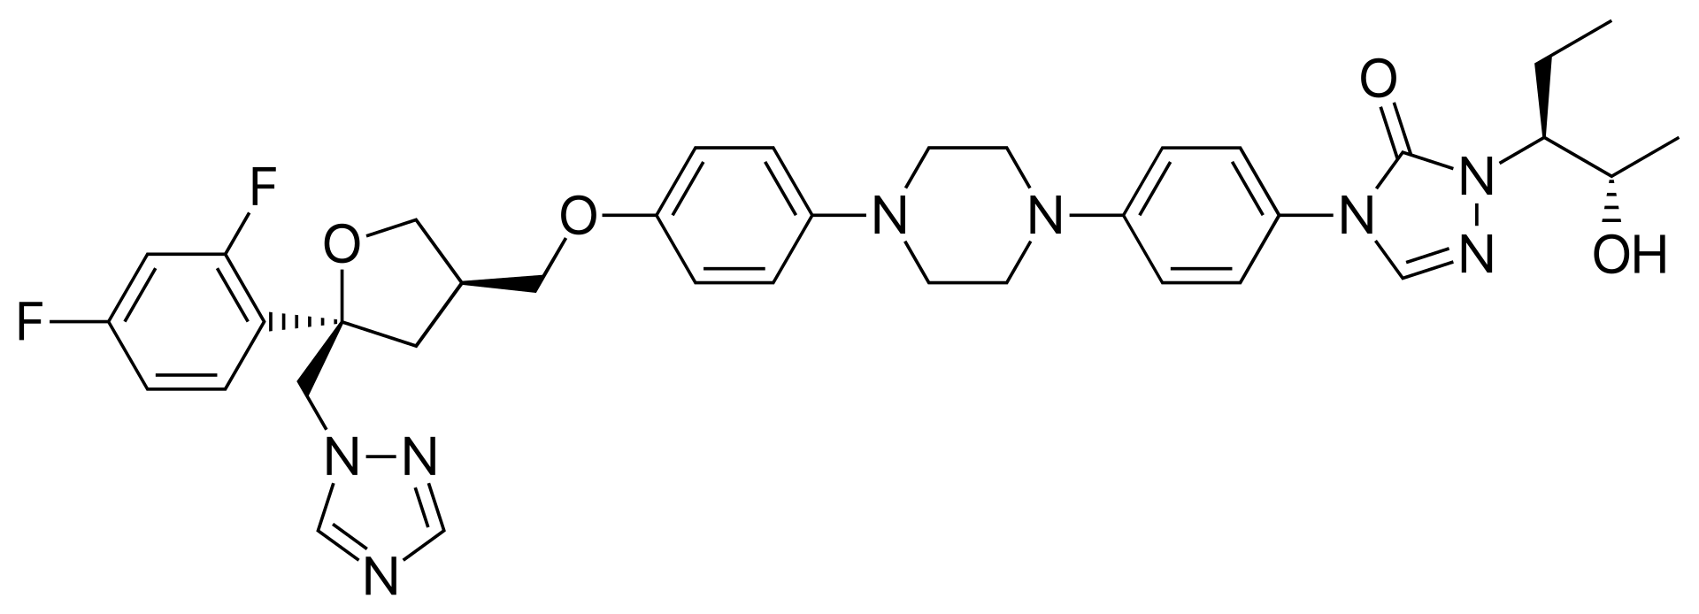
Antifungals in Agriculture and Healthcare

Slide 23
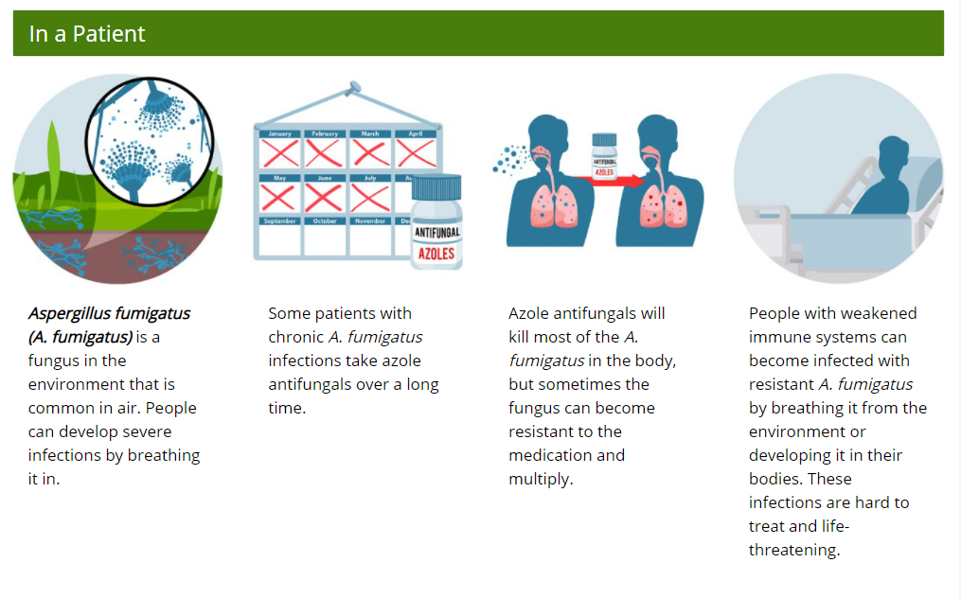
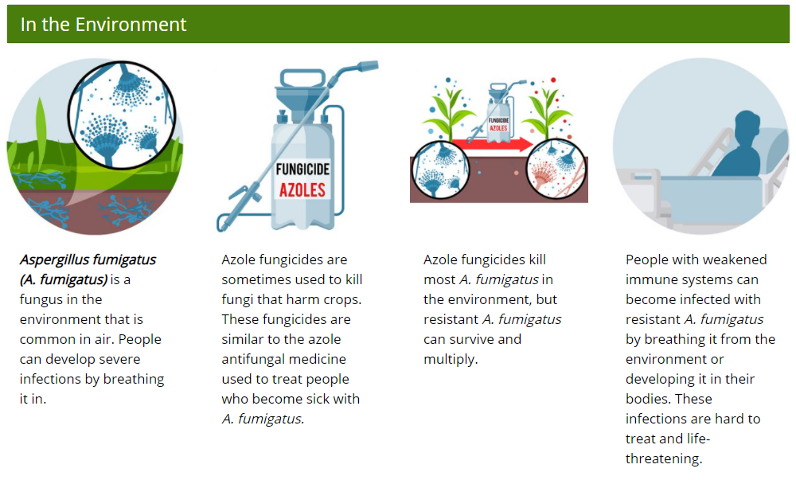
A. fumigatus can evolve resistance to Azoles
https://www.cdc.gov/fungal/diseases/aspergillosis/azole-resistant-aspergillus.html

Slide 24
Cyp51A and azole resistance in Aspergillus fumigatus
Names of alleles
Promoter
Coding region
point mutations in Cyp51A arise in patients with long-term azole therapy
some patients with azole-resistant infections have never received azole drugs
Two cyp51A genotypes confer pan-azole (cross) resistance:
L98H
34bp
34bp
Tandem Repeat of 34 bp = TR₃₄
Amino acid at position 98 has mutated from Leucine (L) to Histidine (H) = L98H
Y121F
T289A
46bp
46bp

